Slide 1
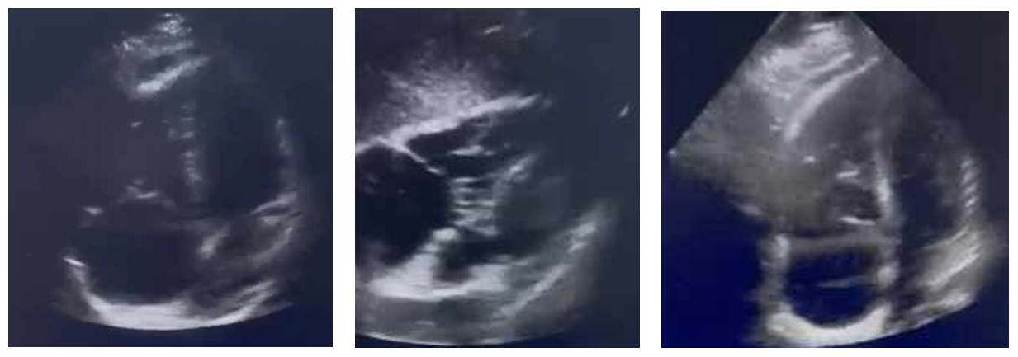
Thrombolysis of massive proximal pulmonary
embolism
Samet Amal, Lassouad Chaima, Ben Amor Khaireddine, El Abassi Omar, Atia Hakim, Chalbaoui Ahmed, Guiza Wafa, Ben Miled Alaa, Nbaya Mohamed Ali, Rejab Imen
Hammadi J, Khalaf B, Rejab
Service des urgences, Hôpital universitaire de Gabes
Poster N°: 82
Introduction:
Pulmonary embolism (PE) is a common condition associated with high morbidity and mortality,
particularly when diagnosed late. Thrombolysis, well-established for severe PE, remains debated for intermediate forms.
Clinical Case:
A 42-year-old woman with a history of femoral diaphysis fracture presented with chest pain
and resting dyspnea after a road traffic accident. She had respiratory symptoms onset two days prior, along with a flu-like syndrome.
On examination, she was in shock with an oxygen saturation of 76%, low blood pressure (78/46 mmHg), high pulse rate (132 bpm), and respiratory acidosis (pH=7.25).
D-dimer levels were significantly elevated, and echocardiography showed dilation of the right chambers and right ventricular dysfunction.
The diagnosis of massive pulmonary embolism was made, and thrombolysis was promptly initiated.
After obtaining consent, a10mg bolus of Actilyse was given, followed by 90mg over two hours. The treatment was complemented by heparin.
The patient’s condition improved rapidly, and a CT pulmonary angiogram confirmed bilateral massive pulmonary embolism without signs of infarction. After 24 hours, echocardiography showed resolution of right ventricular dysfunction.
Figure 1: Transthoracic echocardiography
Conclusion:
Thrombolysis remains a therapeutic option in certain cases of massive and bilateral pulmonary
embolism, even in the absence of confirmatory scanning

